Slide 1

Predicting Customer Churn for Abuja Electricity Distribution Company (AEDC)
Identify customers likely to stop using AEDC and enable proactive retention actions.
Mentee: Bwatna Kuyembo
Mentor: Mr. Isreal Odeajo
Group: 3MTT C2 Data Science (116).

Slide 2
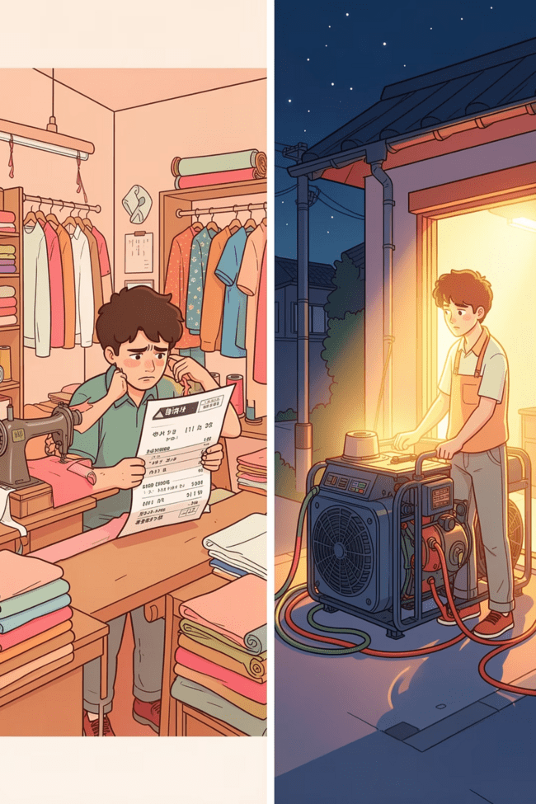

A Day that Becomes a Churn Story
Visual narrative: billing surprise + unresolved complaints + an easy off-grid alternative = lost customer. This single-frame story highlights the trigger sequence AEDC must interrupt.
1
2
Billing Shock
Service Friction
Unexpected bill increases without clear explanation.
Long outage duration and slow/no response from customer care.
Easy Exit
Generators and solar inverters make switching away feel simple.

Slide 3
Problem Statement
Build a machine-learning system to identify AEDC customers in Abuja who are likely to churn, using data of billing, complaints, outage, tariff, and demographic data. The model should deliver early warnings that trigger targeted retention actions such as discounts, callbacks, inspections, or bill corrections.
Business Impact
Data Inputs
Outcome
Reduce revenue loss, protect infrastructure ROI, and strengthen customer trust.
Billing history, outage logs, complaints, tariff class, demographics, and arrears.
A deployable early-warning model that routes high-risk customers into retention workflows.

Slide 4
Project Overview & Churn Prevention Solution
We transformed 2,500 customer records into a production-ready churn scoring pipeline. A Random Forest model scores active customers each billing cycle, and those above a tuned probability threshold are routed into retention workflows — shifting churn management from reactive response to targeted prevention.
1
2
3
Build Risk Signals
Balance and Train Models
Score and Route Customers
Created Outage_Burden, Debt_To_Income, Cost_Per_kWh, and Sat_Complaint_Ratio.
Applied a SMOTETomek pipeline to address class imbalance, then trained RF and LR models with stratified CV.
RF probability thresholds direct customers to standard or senior retention teams based on risk.

Slide 5

Tools, Data & Modeling Stack
Data Sources
Data Prep
Models
Deployment
Key technologies: Python (Pandas, Matplotlib), scikit-learn (GridSearchCV, StratifiedKFold), SMOTETomek for class-balance, Random Forest & Logistic Regression for modeling; evaluation via confusion matrices and ROC-AUC.

Slide 6
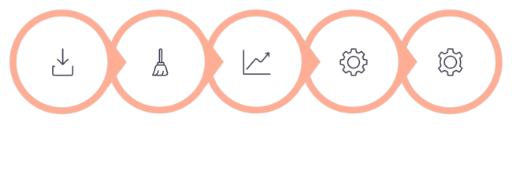
Methodology — Minimal diagram of steps
Clean & Impute
Train Models
Data Load
EDA
Feature Eng
Highlights: median/mode imputation, outage_burden = frequency × duration, debt_to_income normalization, SMOTETomek applied only to training folds, threshold tuning to meet operational goals.

Slide 7
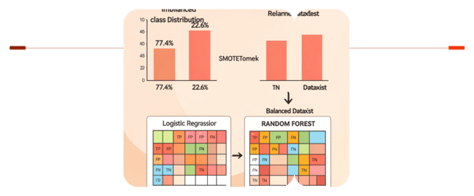
Key Results — Turning Imbalance Into Actionable Signals
Identify the Imbalance
Rebalance Training Data
77.4% retained, 22.6% churned
Apply SMOTETomek to create parity
Baseline imbalance was substantial: 77.4% no-churn versus 22.6% churn. We corrected this in the training set with SMOTETomek to improve model learning.
Feature analysis highlighted Debt_To_Income and Outage_Burden as the strongest predictors. Amount_Paid was retained, while VAT and Service_Charge were removed to reduce multicollinearity.
In the confusion matrices, logistic regression prioritized recall, catching more churners but producing more false alarms. Random forest delivered higher precision with fewer false positives, making the choice dependent on retention capacity.

Slide 8
Final Recommendations — Clear, actionable, and professional
1
2
1. Deploy Random Forest (primary)
2. Keep Logistic Regression in shadow
Score customers each billing cycle. Default action thresholds: 0.35 (outreach), 0.55 (retention queue), 0.80 (senior escalation).
Use for explainability and printable scorecards to justify outreach decisions during appeals.
3
4
3. Operationalize targeted interventions
4. Measure & iterate
Prioritize arrears resolution (debt restructuring), fast meter inspections where billing anomalies appear, and SLA-driven outage-response communication.
Track retention conversion, cost per saved customer, and model drift; retrain quarterly with fresh labels and feedback from retention outcomes.
Closing points: churn is driven by arrears, outage duration, and poor service response — not outages alone. A combined ML + human retention workflow preserves revenue, restores trust, and makes AEDC's investments sustainable.

